Slide 1
Activity Classification from Sensor Data
DRAFT

Slide 2
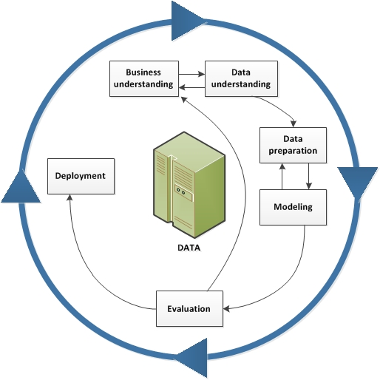
CRISP-DM Framework
Business Understanding
Over 95% of US population own a smartphone and over 25% of adults now owns a wearable like a smart watch. These communication devices are equipped with sensors such as accelerometer, gyroscope and magnetic sensor to determine location and movement. Naturally many of these sensor data are used in healthcare or monitoring application
Using these sensor data from accelerometer, gyroscope and magnetic sensor, the device can leverage a classification model to predict the activity such as standing, sitting, sleeping, to movement such as walking, running and falling.
These model can be released as an API through an operation system where it can applied to consumer devices such as smartwatch, smartphone, fitness tracker, IoT tracker, VR headset, etc.

Slide 3
Design THINKING
Empathize | Define | Ideate | Prototype | Test
For monitoring application, the wearable can be used to track an user daily activity to better understand their movement throughout the day as an API of an OS platform such as Android and iOS. | What data should this activity classifier API serve? | Build an activity classification model as an API | Dataset is modified to maximize the classification model’s accuracy. Several models are used to evaluate the best model. | Recruit participant to perform all target 6 activities while wearing a smartphone. An application is preloaded on the phone to capture raw signals from sensors.
Activities track: Laying Down Standing Sitting Walking Walking upstairs Walking downstairs | Developer would leverage the sensors (accelerometer and gyroscope) in the device. They would call the activity classifier API to identify what activities the user have done | The API should take raw signals from accelerometer and gyroscope where it generate time-series signals in X, Y and Z axis | Models include: Logistic Reg (Multinomial) SVM Decision Tree kNN | After model has train data (70% of the set), one can use a test set to compare with the prediction model. The model is assessed the based on training data compare with test data on its possible. One can evaluate based on error rate.

Slide 4
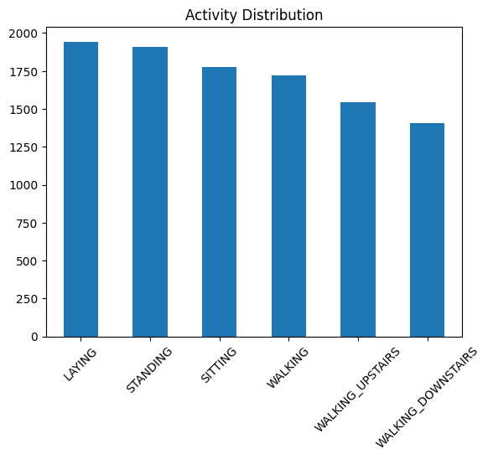
DatA Understanding & Exploration
Data Transform
Activity Distribution
Analog
accelerometer
Analog
gyroscope
X
Y
Z
X
Y
Z
Time domain signals
Band Filter
Time domain signals
convert
convert
X
Y
Z
Fourier Transform
X
Y
Z
Freq domain signals
Freq domain signals
Angular Acceleration
Gravity
Body
Jerk
Magnitude

Slide 5
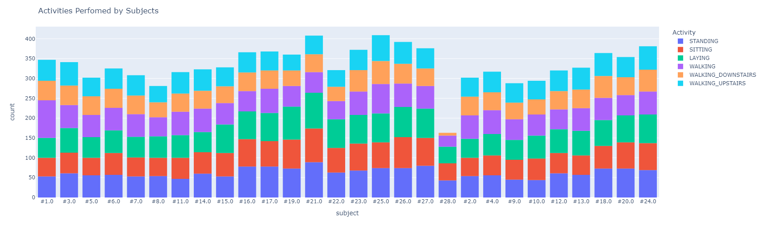
DatA Understanding & Exploration
Activity Distribution by Subject

Slide 6
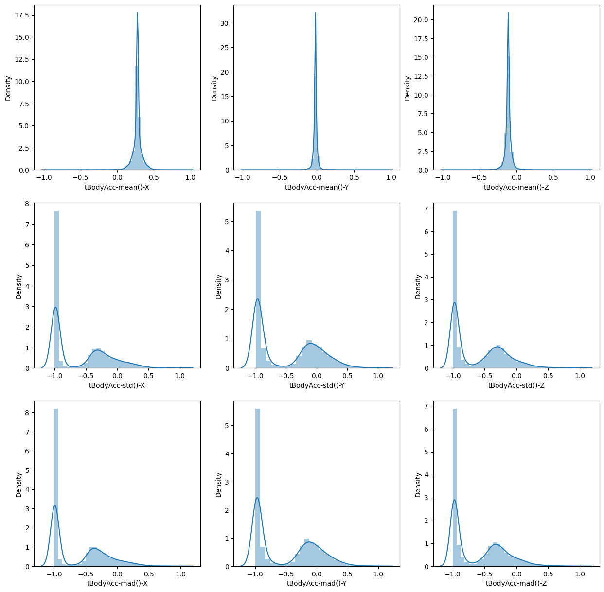
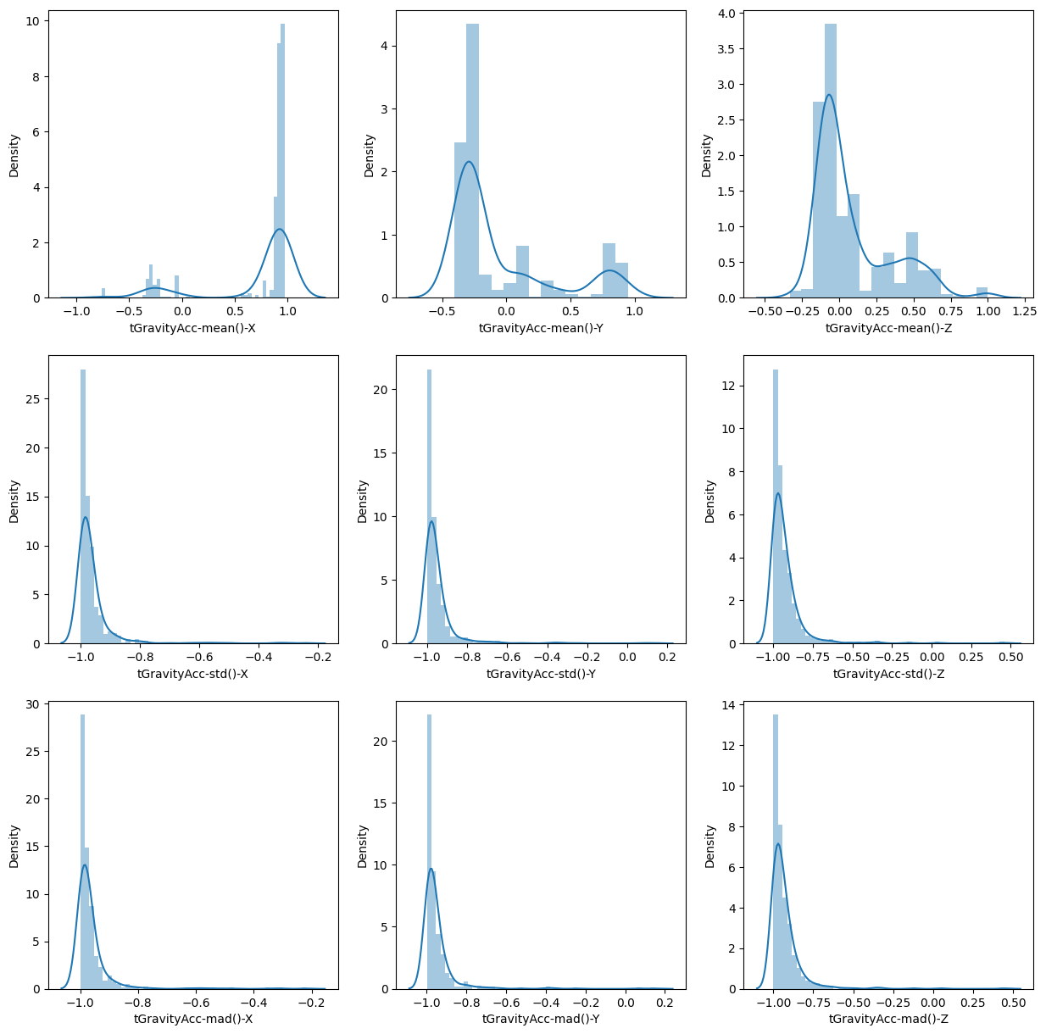
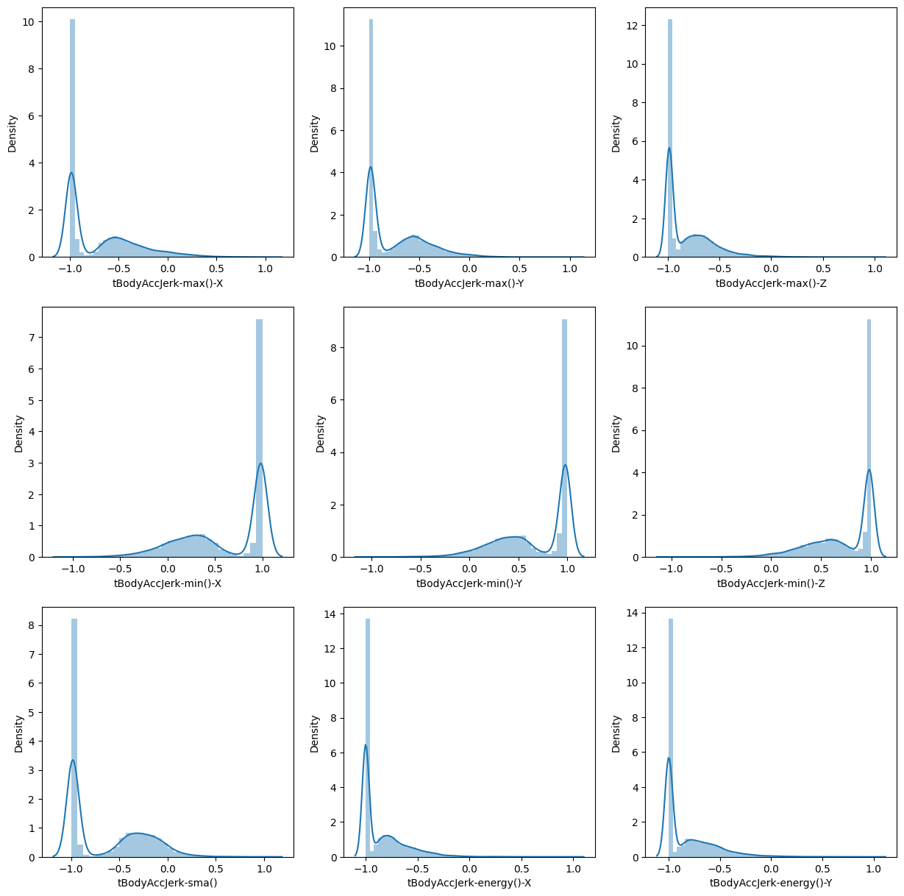
DatA Exploration & Findings
Distribution Plots on Time Domain
tBodyAcc
tGravityAcc
tBodyAccJerk

Slide 7
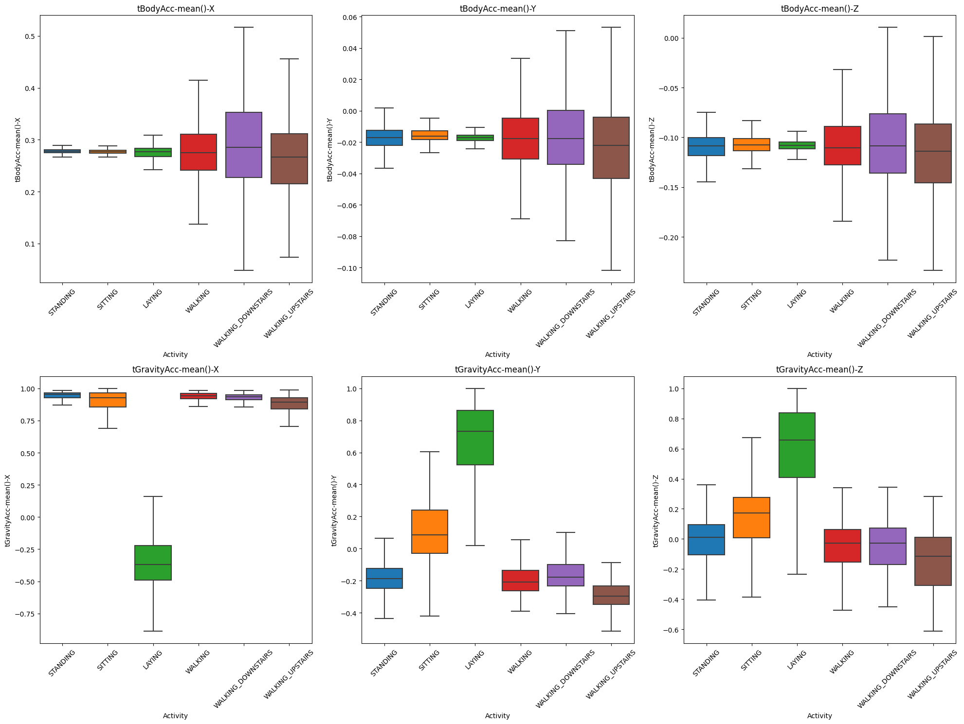
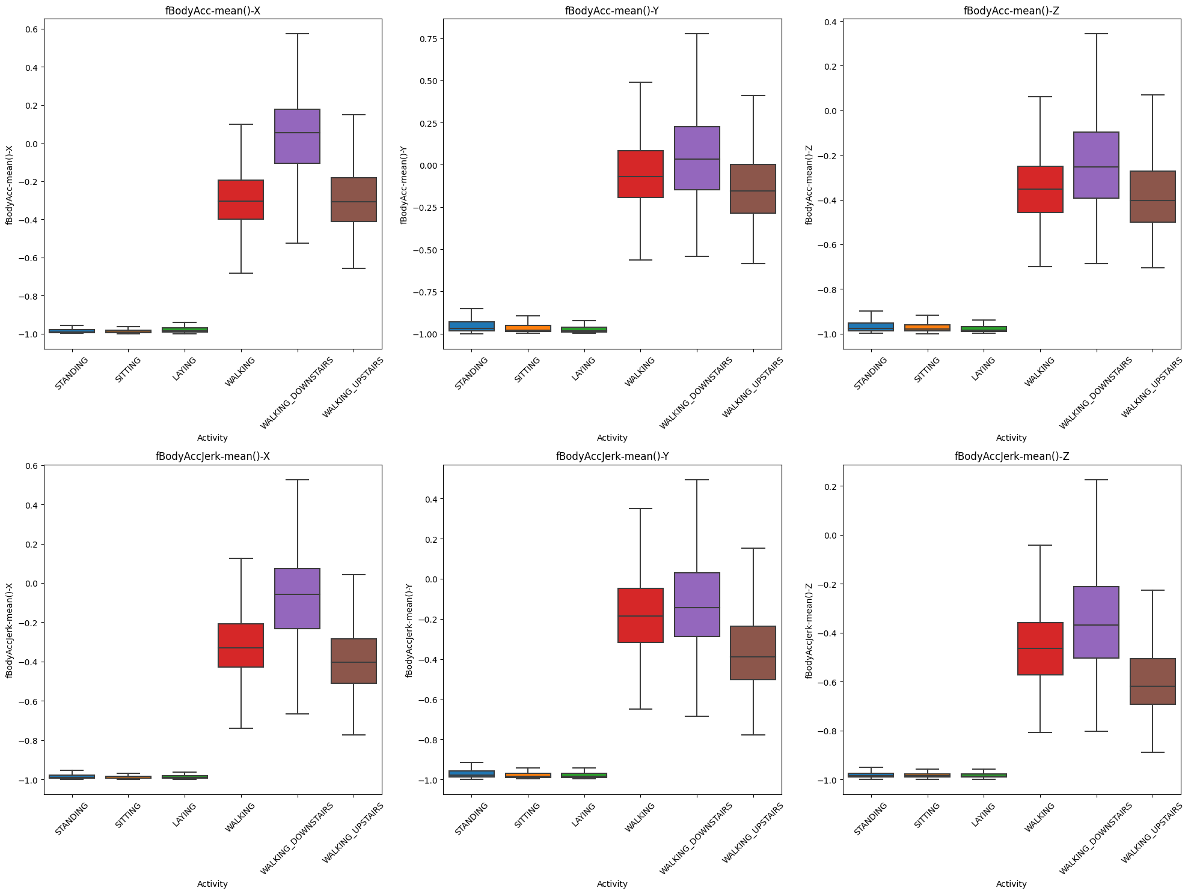
DatA Exploration & Findings
Time Domain vs Frequency Domain
Time Domain
Frequency Domain

Slide 8
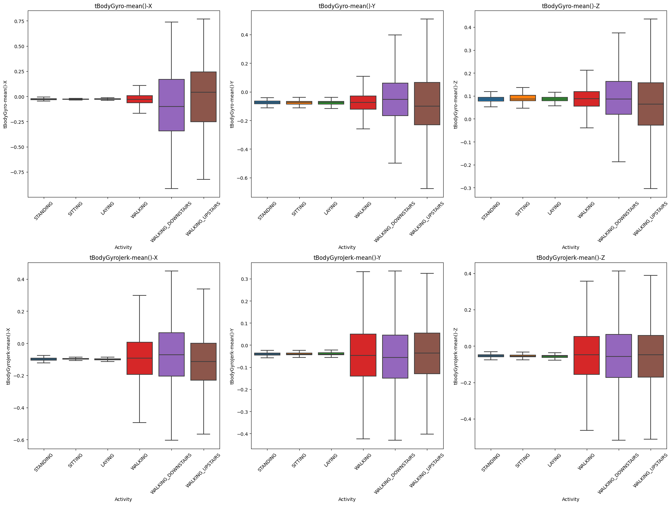
DatA Exploration & Findings
Accelerometer vs Gyroscope
Accelerometer Signals
Gyroscope Signals

Slide 9
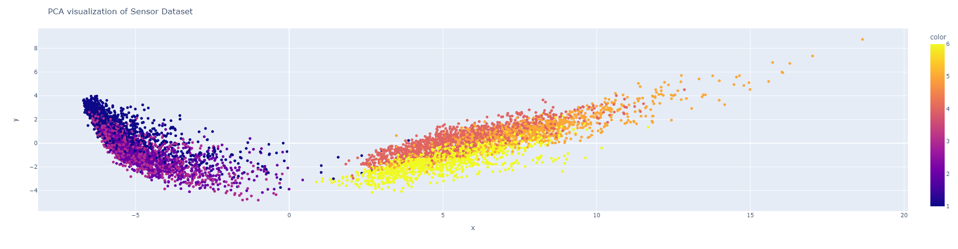
DatA Exploration & Findings
Clustering
PCA = 3
PCA = 2

Slide 10
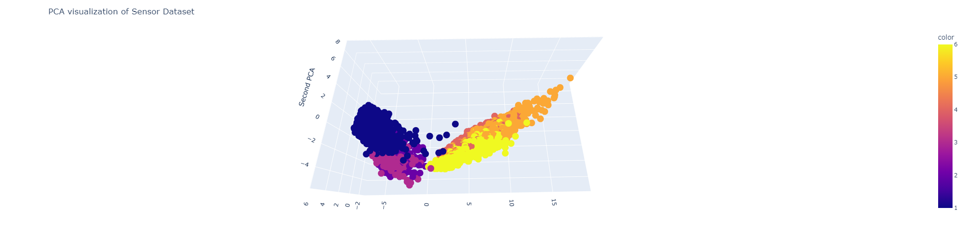
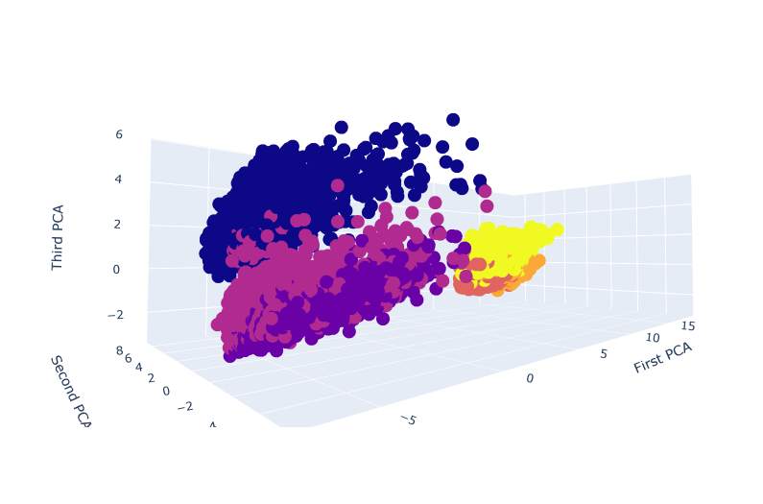
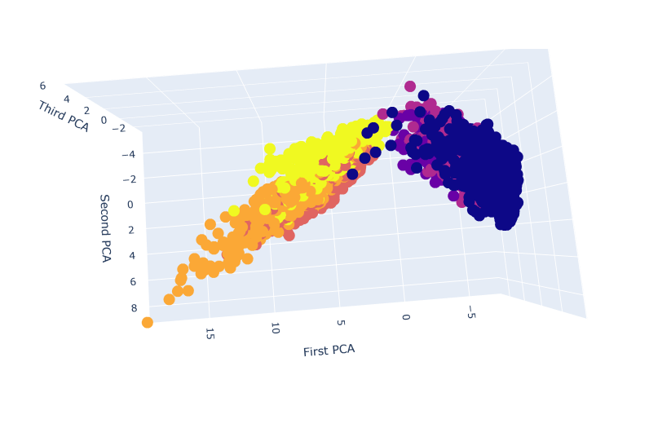
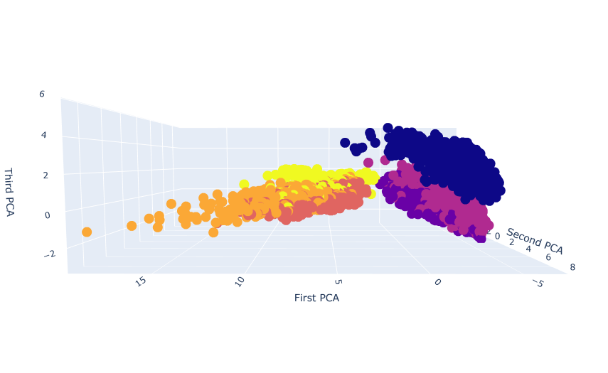
DatA Exploration & Findings
Clustering
PCA = 3

Slide 11
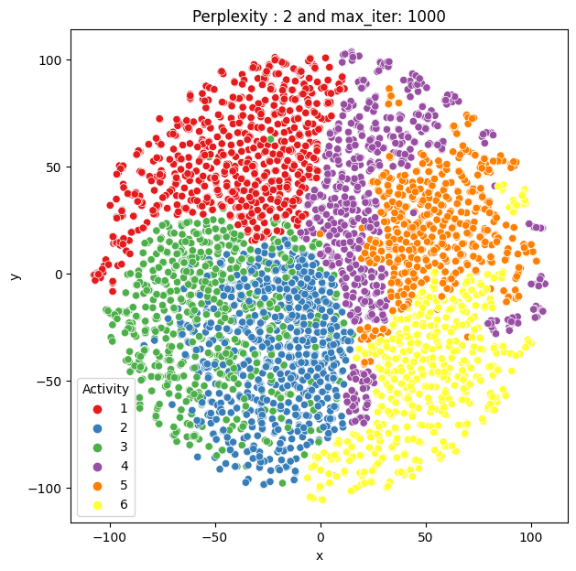
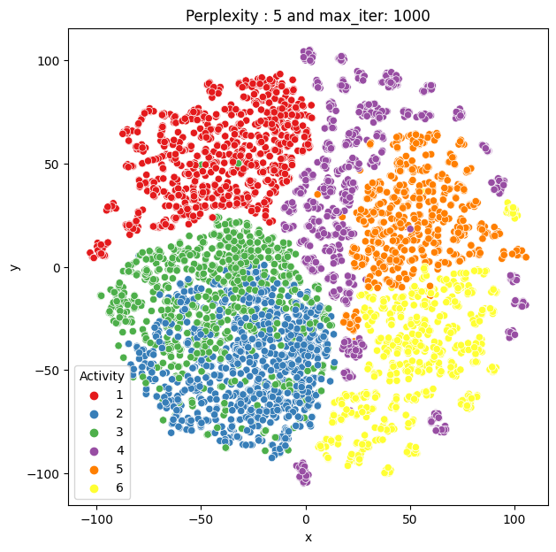
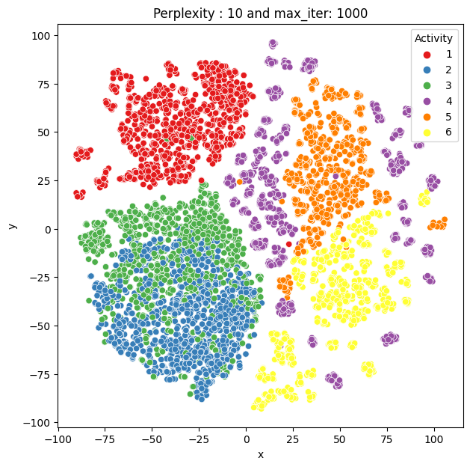
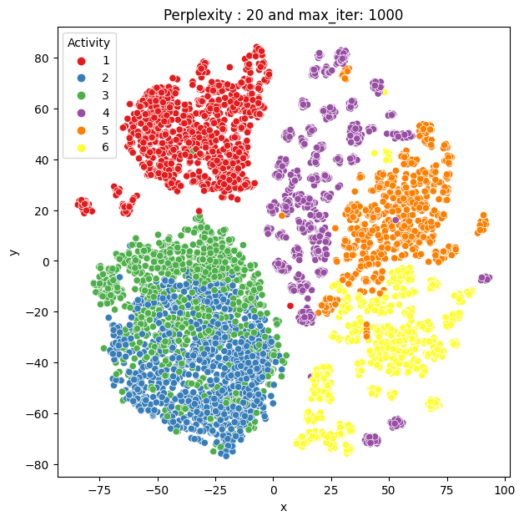
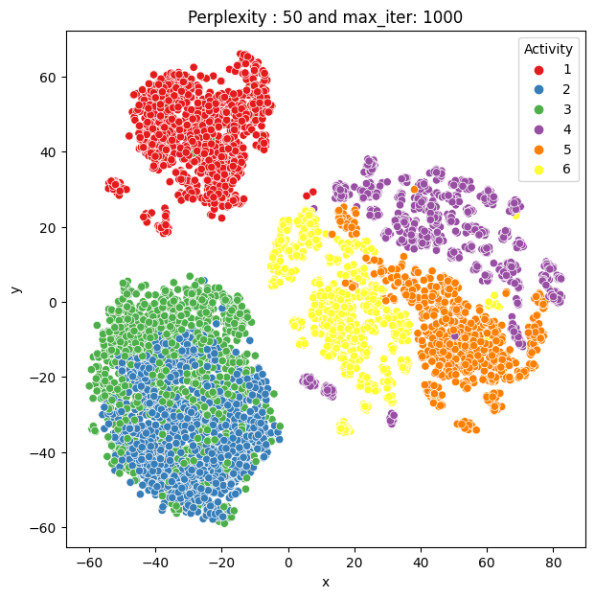
DatA Exploration & Findings
Visualization using t-SNE (T-distributed Stochastic Neighbor Embedding)
Perplexity = 2
Perplexity = 5
Perplexity = 10
Perplexity = 20
Perplexity = 50
T-SNE can help reduce the dimensionality of the dataset. Perplexity is a tuning parameter which balance the attention between local and global aspect of the data. The typical value is between 5 to 50.
Based on the visualization above of perplexity value of 2, 5, 10, 20 and 50 with a fixed iteration of 1000. You can see that some pattern in the cluster. Among the activity, 3 of the activities are stationary (#1, #2, #3) and other 3 are in motion when participant is walking (#4, #5, #6)
Coincidently, ‘stationary’ clusters are grouped together separated from the ‘motion’ clusters. One explanation is that gravitational and angular acceleration component is changing in periodic pattern when the participant is walking.

Slide 12
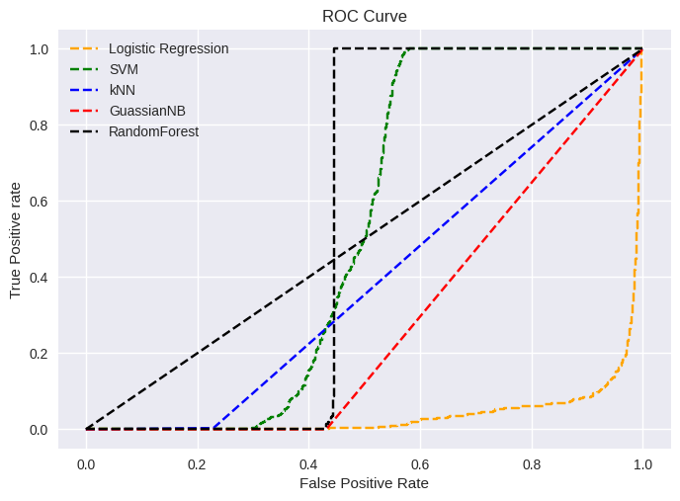
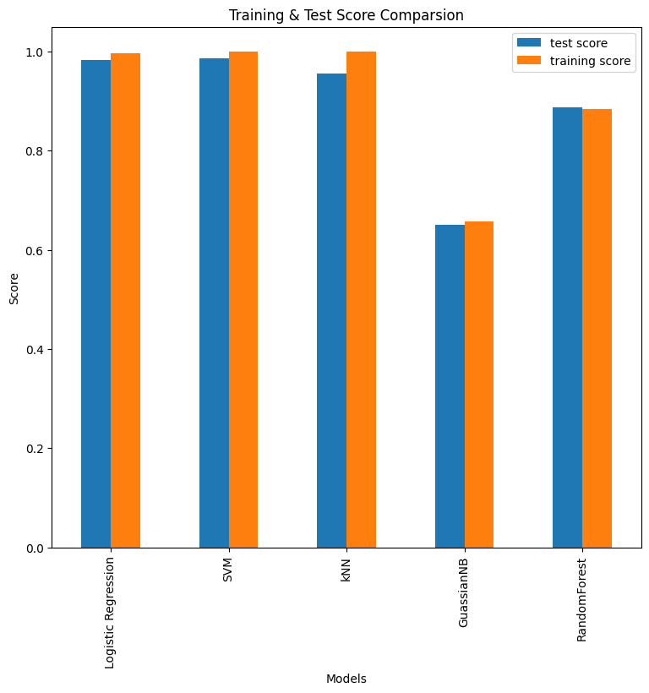
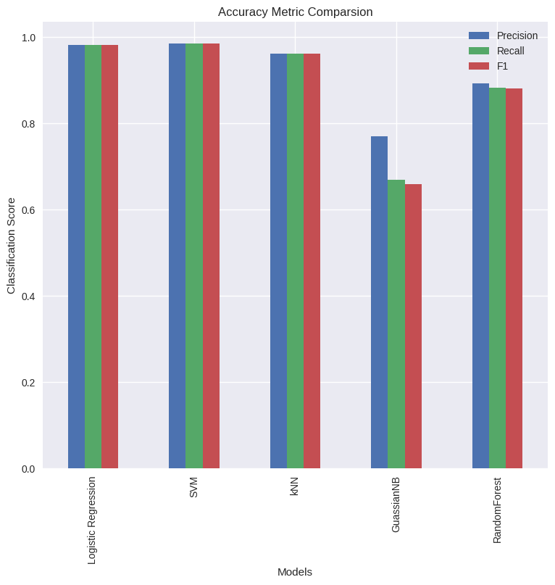
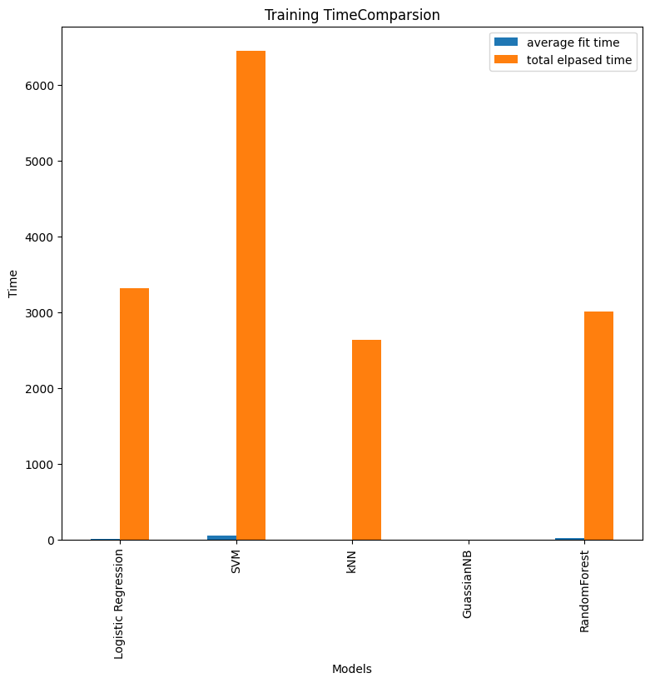
Data Modeling & Evaluation
5 Models are evaluated as an activity classifier:
5 Models are Evaluated to implement the Activity Classifier
Logistic Regression with Multinominal
SVM
kNN
Gaussian Naïve Bayes
Random Forest Classifier
Based on Test Score generated by gridSearchCV, SVM model has the highest test score with its best parameters. Closely follow by Logistic Regression using multinomial. This is verified using accuracy metric generated through classification report. SVM yield the highest Precision, recall and F1 value. However the downside of SVM is reflected in training time as it takes at least 2x to 3x as long compare to other models.
Regarding ROC Curve, SVM and Random Forest has the highest

Slide 13
THANK YOU

